Slide 1

Navigation aid for the …..Visually Impaired
DFP Design Evaluation
DFP Group No. 39
Mentor: Dr. Dinesh Kumar V.

Slide 2
Group No. 39
TEAM MEMBERS
Aryan 22BSM010
Amit Kumar 22BEC011
Aman Dhoke 22BCS024
Satwik Baruri 22BDS034
Shreyansh Tripathi 22BME057
Archakam Sree Chaitanya 22BCS041

Slide 3
Timeline
2024
2025
SEP -OCT
NOV - DEC
JAN
FEB
MAR
APR
Problem Identification
Final Model
Primary research
Technology Exploration
Design Ideation
Prototyping
Testing & Fabrication
Observation, problem identification, Survey
Research regarding tech used, specification
Ideation, concept, CAD model
Selection of Final ideation, Code simulation
3D printing, Hardware, Software

Slide 4
Table of Contents
Core Motivations
Novelty & Functionality
Design Detailing
Technical/Product Specs.
Circuit Diagram
Working
Bill Of Material
Time & Cost Estimates

Slide 5
Core Motivations
Detecting obstacles at varying Heights and Distances
Combined with algorithms for accurate identification, mapping, and real-time processing
Navigation in Unfamiliar environments
AI-powered systems to provide real-time guidance and ensure safe, efficient movement
Accessible and Reliable assistive technology
Enhancing independence, communication, and mobility through user-friendly and dependable solutions
Enhancing Quality of Life
Providing accessible assistive technology to make visually impaired comfortable

Slide 6
Novelty
04
AI Enabled Pothole Detection
Compatible to Use
Detects uneven patches over surface
Easy to use for visually impaired person. Plug and play.
01
03
Hands free
Navigation System
Reliable and High accuracy, real time operation with minimal cognitive load.
With the help of google maps, it guides user for real time routes and also provide their live location to caretakers.,
02

Slide 7
Functionality
1.
3.
Real-Time Obstacle Detection
Dynamic Alerts
Notifies users of moving vehicles, approaching people, or other environmental changes for enhanced situational awareness.
Identifies obstacles like walls, poles, and vehicles using sensors such as LiDAR, cameras, or ultrasonic sensors.
2.
4.
Turn-by-Turn Navigation
Wearable Design
Headset form with adjustable straps or padding for secure, comfortable, and user-friendly mobility.
Utilizes GPS and pre-mapped routes to guide users effectively.

Slide 8
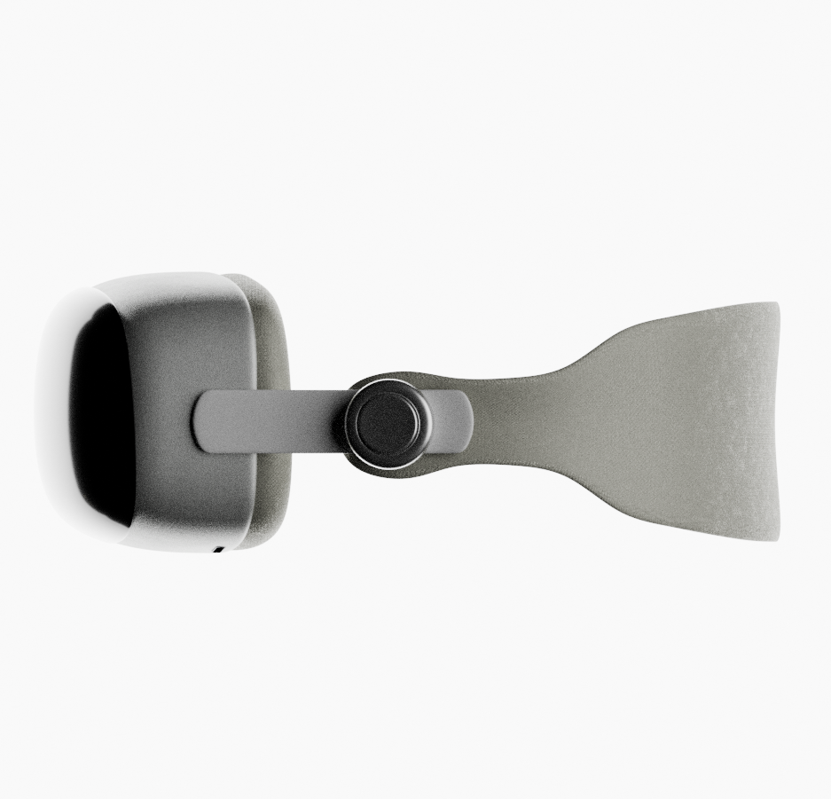
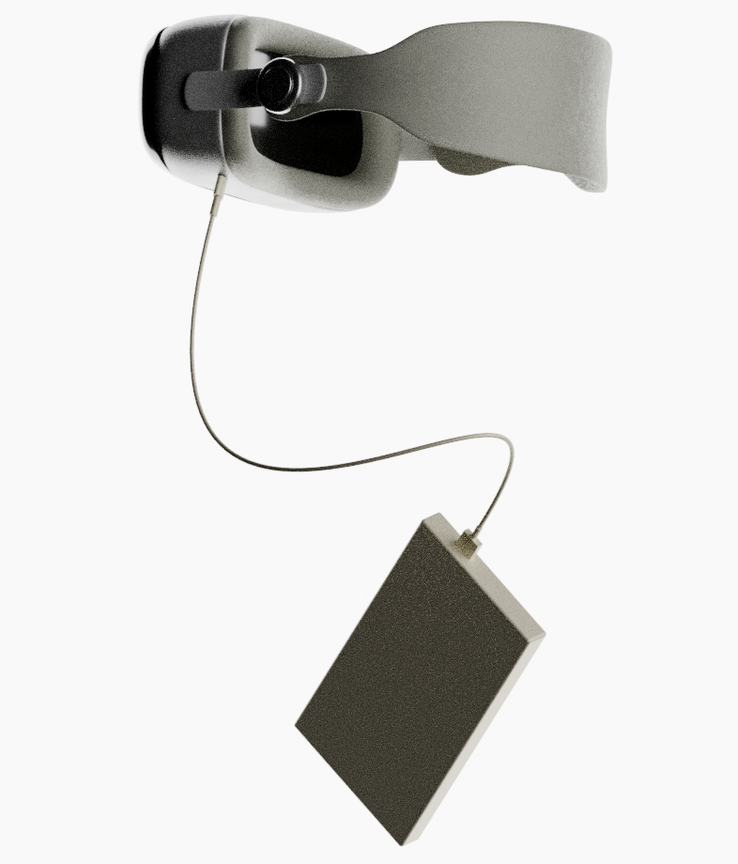

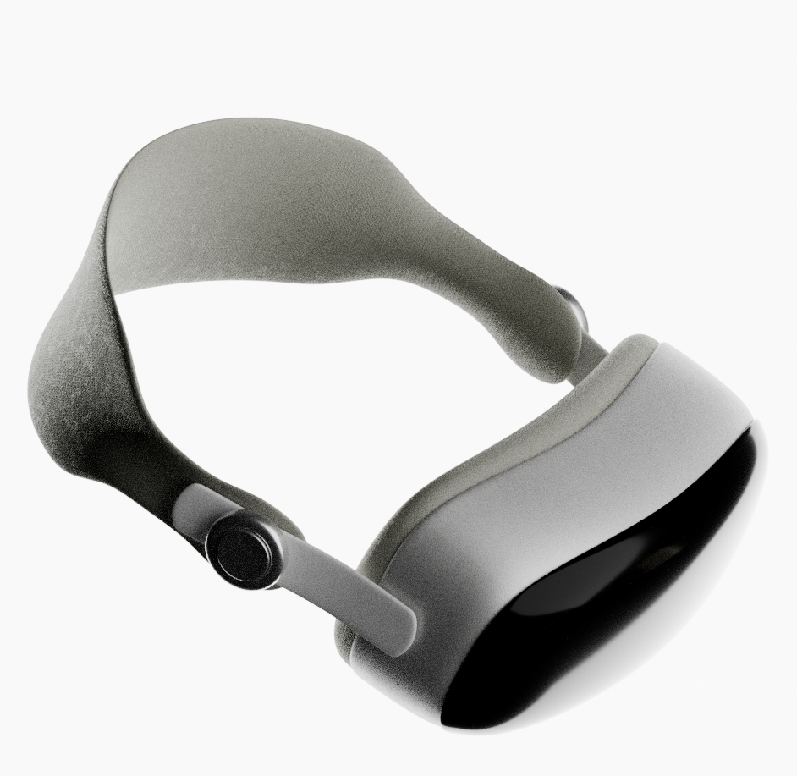
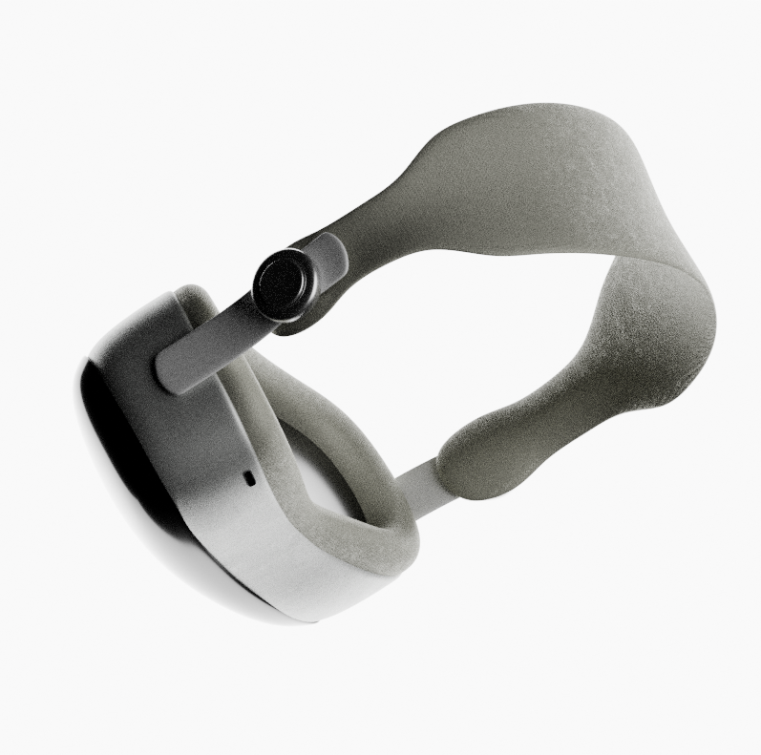
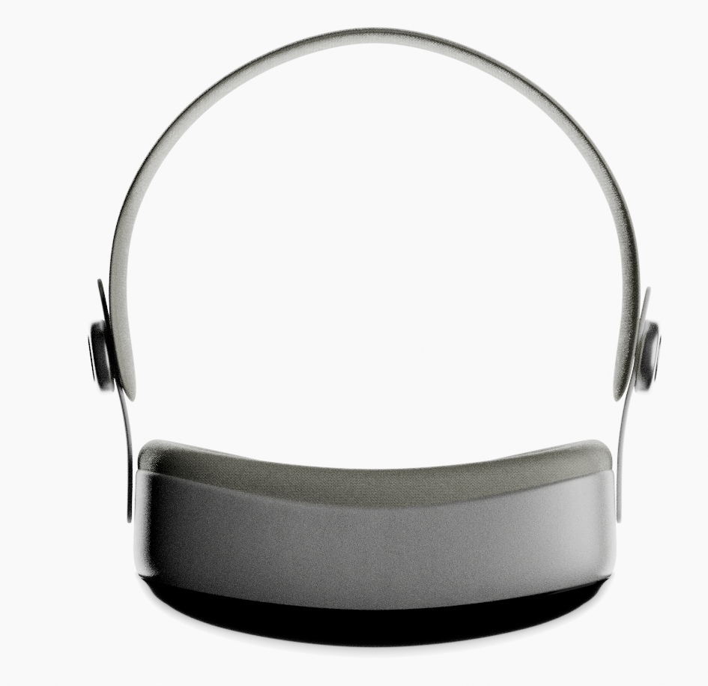
Product Concept

Slide 9
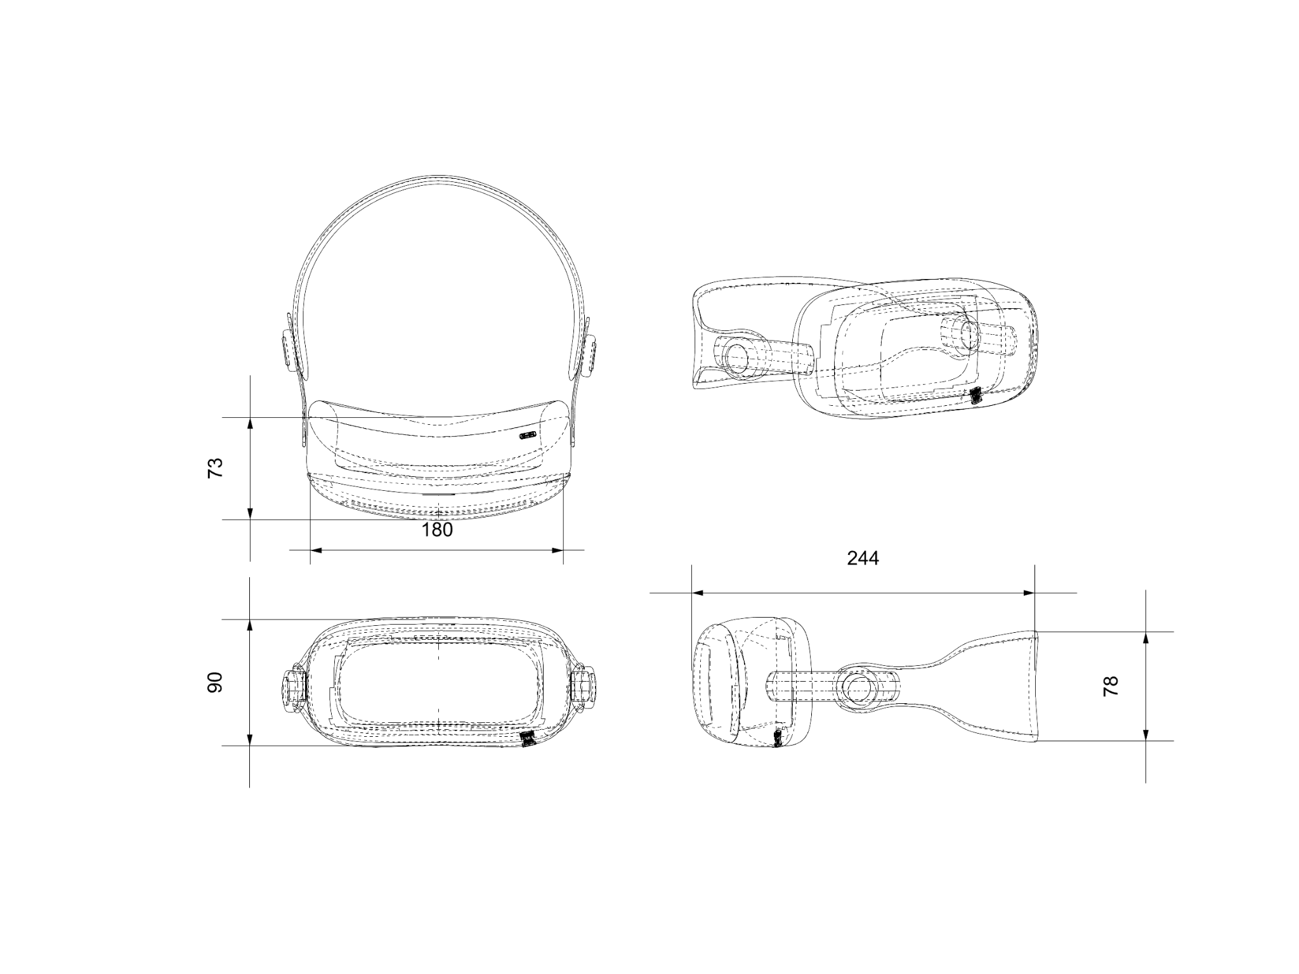
Technical Drawing

Slide 10
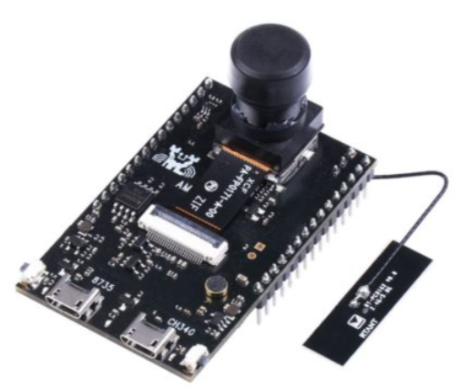
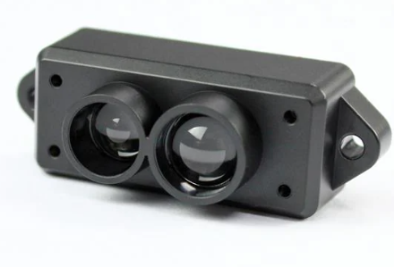
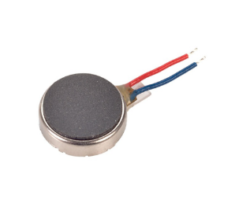
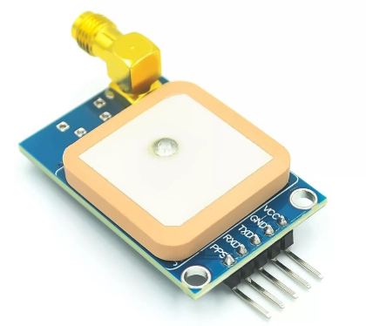
Technical/Product Specs.
AMB 82-Mini
LIDAR
Vibrational Motors
GPS Module
A specialized AI-enabled imaging and video processing platform
Offers high resolution mapping and precise detection of medium to long-range obstacles
operate on a principle involving the detection of vibrations by objects interacting with the sensor.
It navigate the visually impaired person show the live location in mobile app

Slide 11
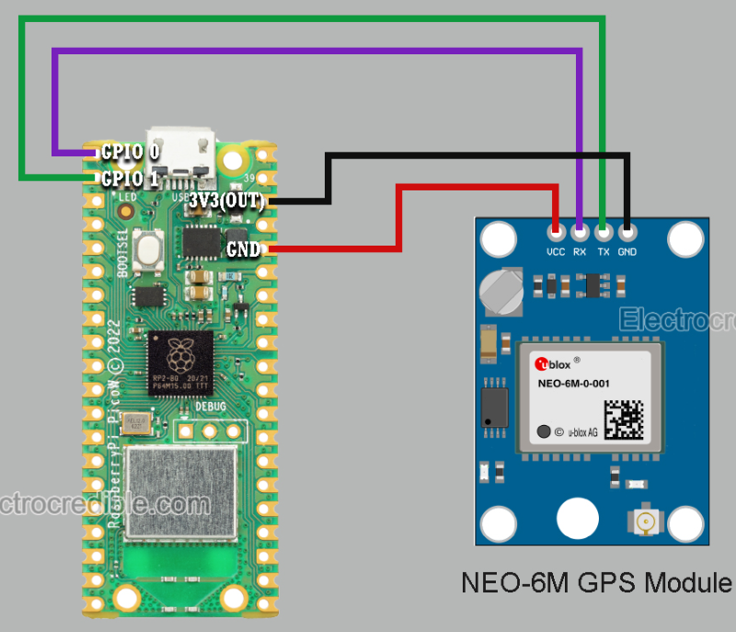
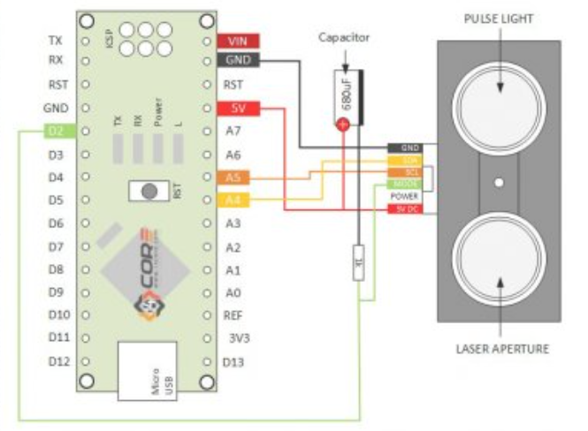
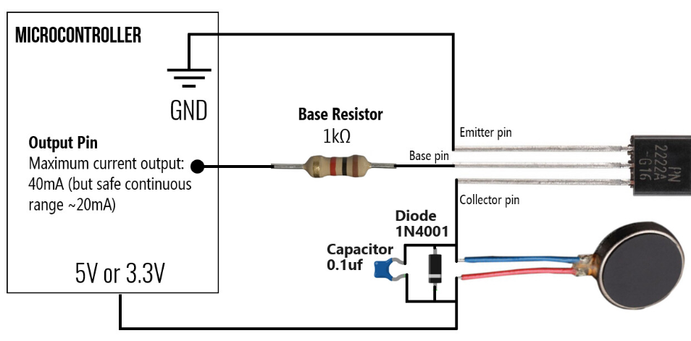
Circuit Diagram
1.
2.
2.
1. GPS Module Connection with AMB82
2. LiDAR Connection with AMB82
3. Vibrational Motor Connection with AMB82
3.

Slide 12
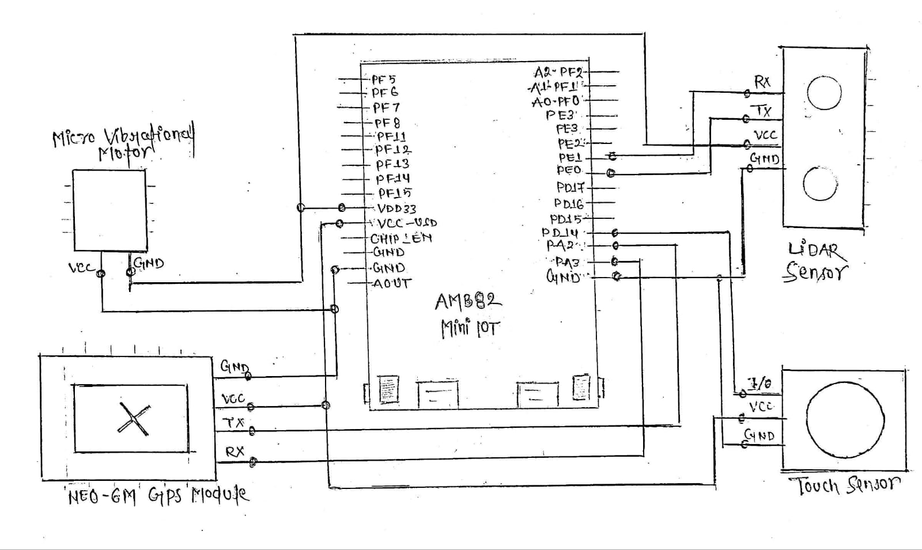
Circuit Diagram

Slide 13
Working
The AMB82 Mini IoT Cam detects potholes, objects, obstacles, and danger signs in the surroundings with precision.
A LiDAR sensor accurately measures the distance of objects and potholes for reliable detection.
The NEO-6M GPS module, integrated with Google Maps, assists visually impaired individuals by providing navigation support to their caretakers through our mobile system.
A touch sensor allows the device to be turned ON/OFF with a single touch.
Vibrational motors deliver haptic feedback through subtle vibrations, alerting the user to potential hazards.
The model provides accurate information in any environmental or traffic condition, ensuring reliability.
An air conduction band enables clear audio feedback, enhancing user awareness.

Slide 14
Bill of Material
S.No | Name of Components | Quantity | Rate/unit (Rs.) | Total Rate (Rs.) | Justification
1 | AMB 82 Mini Cam | 1 | 2700 | 2700 | To create bird eye For path planning
2 | LiDAR | 4 | 3250 | 13,000 | Used for scanning large external areas
3 | Vibrational Motor | 6 | 60 | 360 | For haptic feedback with vibration
4 | Power Unit (10,000 mAh) | 1 | 1300 | 1300 | Power supply for microcontroller
5 | NEO-6M GPS Module | 1 | 550 | 550 | Used for navigation system

Slide 15
S.No | Name of Components | Quantity | Rate/Unit | Total Price(Rs.) | Justification
6 | CAD Printing | NA | 5000 | 5000 | For fabrication
7 | Connecting wires | NA | 100 | 500 | For connection
8 | USB Cable | 1 | 200 | 200 | Connection Input through System
9 | Earphone | 1 | 1500 | 1500 | For Audio feedback
11 | SD Card | 1 | 150 | 150 | For storage purpose
12 | Miscellaneous | NA | 3000 | 3000 | Miscellaneous expenses
Total Estimated Budget : 28,000 - 30,000

Slide 16
Thank you.

